Slide 1
SQL Server on Containers
Simplifying your database environment

Slide 2
Objectives
What’s a container?
Why don’t I just use a VM?
So why would I do this to my SQL Server?
Thing to keep in mind
Demo: Create a SQL Server on Docker
Kubernetes
What else you got?
Q&A

Slide 3
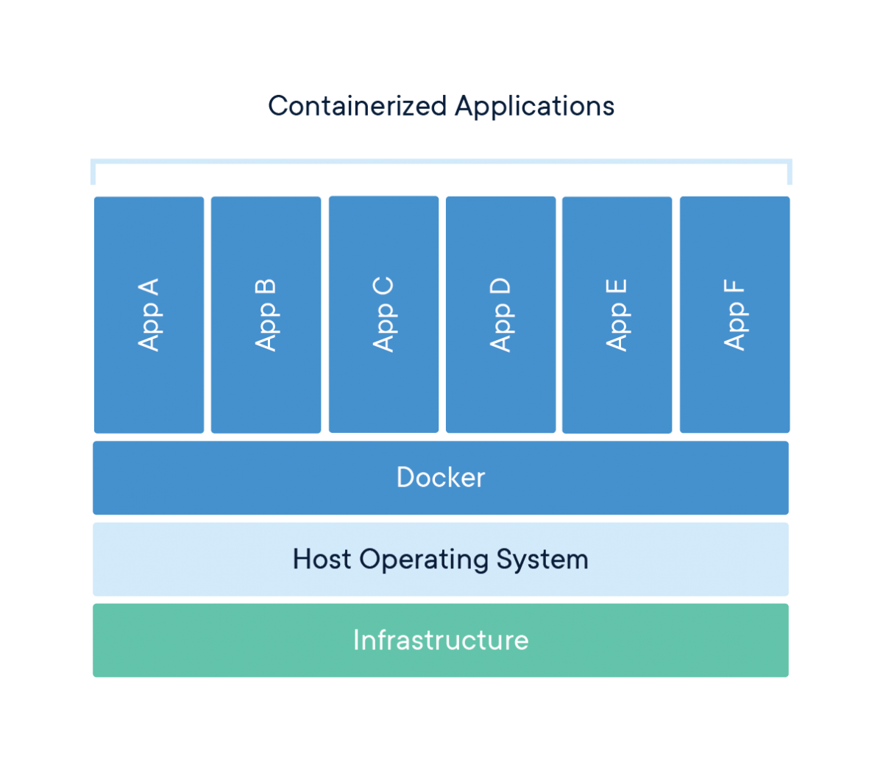
What’s a Container?
A lightweight, standalone, executable package of software that includes everything needed to run an application
Primarily used in Linux but can be used in Windows and major cloud providers
AWS EKS, ECS services
Azure Container Instances and Kubernetes Service (AKS)

Slide 4
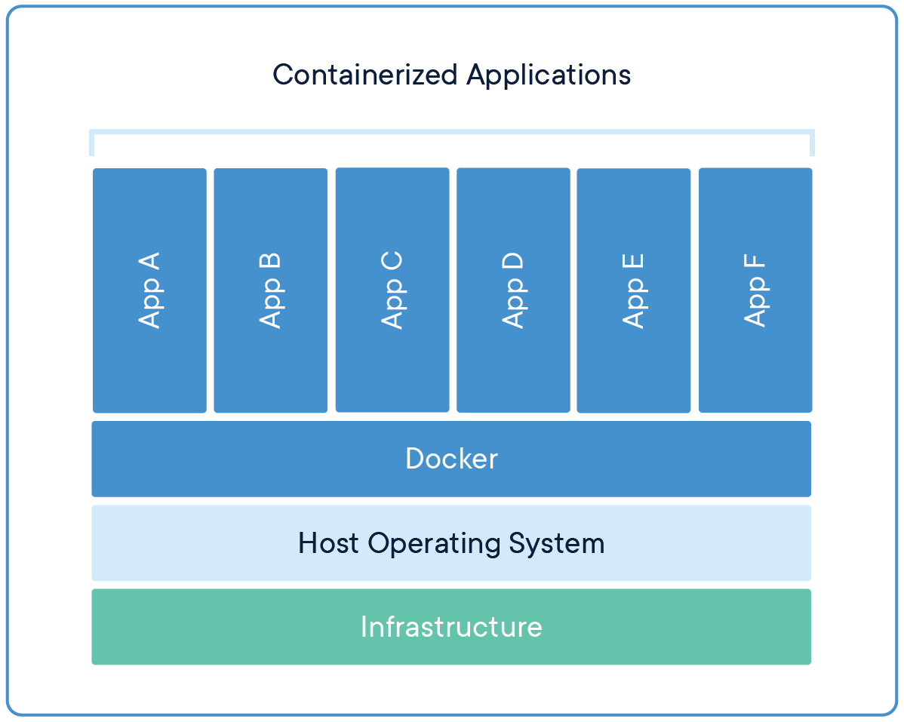
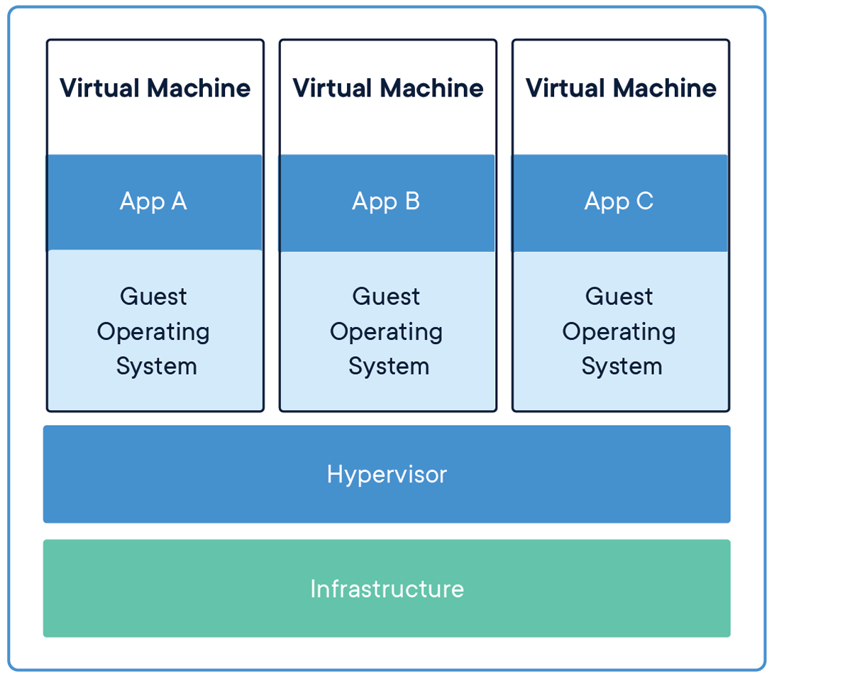
Why don’t I just use a VM?
Abstraction at the app layer
Shares OS from host machine
Runs isolated process
Takes less space (MB’s)
Abstraction of the physical hardware
Once server into many servers each with its own OS
Can run many processes
Much larger (GB’s)

Slide 5
So why would I do this to my SQL Server?
Better CI/CD pipelines
Faster patching
Separate Compute layer from Data layer
Save money on licensing
Not guaranteed
Easier to create new instances
Quicker to scale out rather than up
Make more nodes to share the load

Slide 6
Things to keep in mind
Your node size is dependent on your host
Not recommended for larger instances
Ideal for testing environments or smaller sharded DBs
Windows containers are not recommended for SQL Server
Best if you use the Linux docker pull via Docker store

Slide 7
Demo: Create a SQL Server on Docker

Slide 8
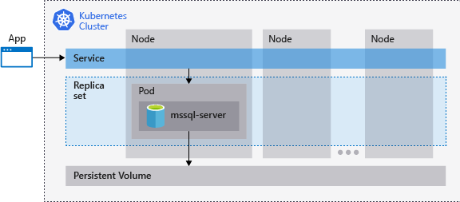
Kubernetes
Kubernetes is a platform for managing containerized workloads and services, that facilitates both declarative configuration and automation
Uses a Pod inside the node to house the DB
Created by Google in 2014 to manage Docker on a large scale
Can be used with SQL Server on Linux and features Availability Groups in 2019

Slide 9
What else you got?
If you don’t want to maintain containers or the setup is to difficult, you can use container cloud services
AWS Elastic Container Service (ECS)
Azure Container Registry
AWS Elastic Container Service for Kubernetes (EKS)
Azure Kubernetes Service (AKS)
AWS Fargate
Google Container Services
Non Cloud Services
Docker Enterprise Edition (EE)
Rancher (Kubernetes Service)

Slide 10
AWS EKS
Elastic Kubernetes Service
Fully managed Kubernetes service
No need to maintain the node as it is managed by AWS in the background
Can be run serverless (Fargate)
Not recommended for SQL Server as it doesn’t work well with persistent volumes
Certified Kubernetes conformant
All open source tools are available for use without needing to retool from standard Kubernetes applications

Slide 11
Demo: Create a SQL Server on EKS

Slide 12
Credits
What is a Container? https://www.docker.com/resources/what-container
Containers in cloud services https://azure.microsoft.com/en-us/overview/containers/ https://aws.amazon.com/containers/services/
Kubernetes https://kubernetes.io/docs/concepts/overview/what-is-kubernetes/ https://docs.microsoft.com/en-us/sql/linux/tutorial-sql-server-containers-kubernetes?view=sql-server-2017
AWS EKS https://aws.amazon.com/eks/
SQL Server on Linux and Docker https://docs.microsoft.com/en-us/sql/linux/sql-server-linux-overview?view=sql-server-2017 https://docs.microsoft.com/en-us/sql/linux/quickstart-install-connect-docker?view=sql-server-linux-ver15&pivots=cs1-powershell
Container Services https://www.cloudtp.com/doppler/managed-container-services-vs-bring-your-own-container-stack/

